Slide 1


Data Mining and Data Warehousing CSE-4107
Md. Manowarul Islam
Assistant Professor, Dept. of CSE
Jagannath University

Slide 2
Today’s topics
Syllabus
Introducing
Exam
Book

Slide 3
Book
Data Mining: Concepts and Techniques
J. Han and M. Kamber
Introduction to Data Mining
Tan, Steinbach, Kumar

Slide 4


Exam
Assignment/ Attendance 10
Mid Term 20
Final Exam 70

Slide 5
Syllabus
Introduction
Data pre-processing
Association rule mining
Classification (supervised learning)
Clustering (unsupervised learning)
Post-processing of data mining results
Text mining
Partial/Semi-supervised learning
Introduction to Web mining

Slide 6
Related Fields
Machine
Learning
Visualization
Data Mining and
Knowledge Discovery
Statistics
Databases

Slide 7
What is data mining?
After years of data mining there is still no unique answer to this question.
A tentative definition:
Data mining is the use of efficient techniques for the analysis of very large collections of data and the extraction of useful and possibly unexpected patterns in data.

Slide 8
Data Mining
Data explosion problem:
Automated data collection tools and mature database technology.
Leading to tremendous amounts of data stored in databases, data warehouses and other information repositories.
We are drowning in data, but starving for knowledge!

Slide 9
Data Rich but Information Poor
Databases are too big
Data Mining can help discover knowledge
Terrorbytes

Slide 10
What is data mining?
Data mining is also called knowledge discovery and data mining (KDD)
Data mining is
extraction of useful patterns from data sources, e.g., databases, texts, web, image.
Patterns must be:
valid, novel, potentially useful, understandable

Slide 11
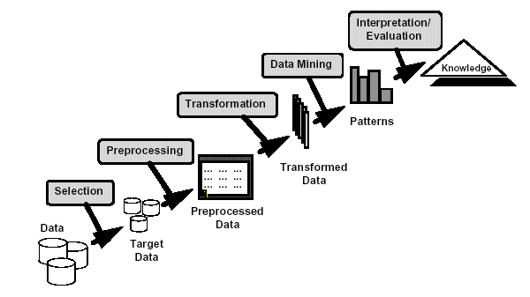
Knowledge Discovery

Slide 12
Example of discovered patterns
Association rules:
“80% of customers who buy cheese and milk also buy bread, and 5% of customers buy all of them together”
Cheese, Milk→ Bread [sup =5%, confid=80%]

Slide 13
Origins of Data Mining
Draws ideas from machine learning/AI, pattern recognition, statistics, and database systems
Traditional Techniques may be unsuitable due to
Enormity of data
High dimensionality of data
Heterogeneous, distributed nature of data
Statistics/ AI
Machine Learning/
Pattern Recognition
Data Mining
Database systems

Slide 14
Database Processing vs. Data Mining Processing
Query
Well defined
SQL
Query
Poorly defined
No precise query language
Output
Precise
Subset of database
Output
Fuzzy
Not a subset of database

Slide 15
Query Examples
Database
Data Mining
Find all credit applicants with last name of Smith.
Identify customers who have purchased more than $10,000 in the last month.
Find all customers who have purchased milk
Find all credit applicants who are poor credit risks. (classification)
Identify customers with similar buying habits. (Clustering)
Find all items which are frequently purchased with milk. (association rules)

Slide 16
Why do we need data mining?
Really, really huge amounts of raw data!!
In the digital age, TB of data is generated by the second
Mobile devices, digital photographs, web documents.
Facebook updates, Tweets, Blogs, User-generated content
Transactions, sensor data, surveillance data
Queries, clicks, browsing
Cheap storage has made possible to maintain this data
Need to analyze the raw data to extract knowledge

Slide 17
Why do we need data mining?
Data is power!
Today, the collected data is one of the biggest assets of an online company
Query logs of Google
The friendship and updates of Facebook
Tweets and follows of Twitter
Amazon transactions
We need a way to harness the collective intelligence

Slide 18
The data is also very complex
Multiple types of data: tables, images, graphs, etc
Interconnected data of different types:
From the mobile phone we can collect, location of the user, friendship information, check-ins to venues, opinions through twitter, images though cameras, queries to search engines

Slide 19
Example: transaction data
Billions of real-life customers:
Credit card companies: billions of transactions per day.
The point cards allow companies to collect information about specific users

Slide 20
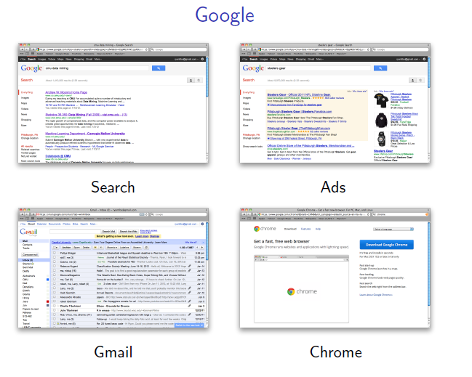
Example: document data
Web as a document repository: estimated 50 billions of web pages
Wikipedia: 4 million articles (and counting)
Online news portals: steady stream of 100’s of new articles every day

Slide 21
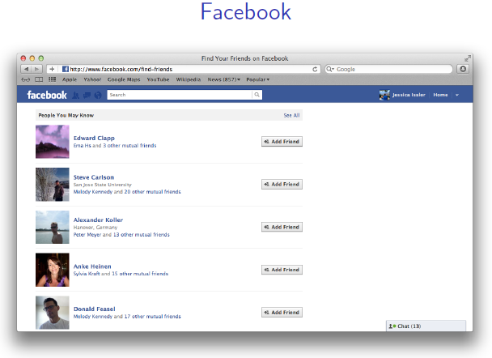
Example: network data
Web: 50 billion pages linked via hyperlinks
Facebook: 500 million users
Twitter: 300 million users
Instant messenger: ~1billion users
Blogs: 250 million blogs worldwide, presidential candidates run blogs

Slide 22
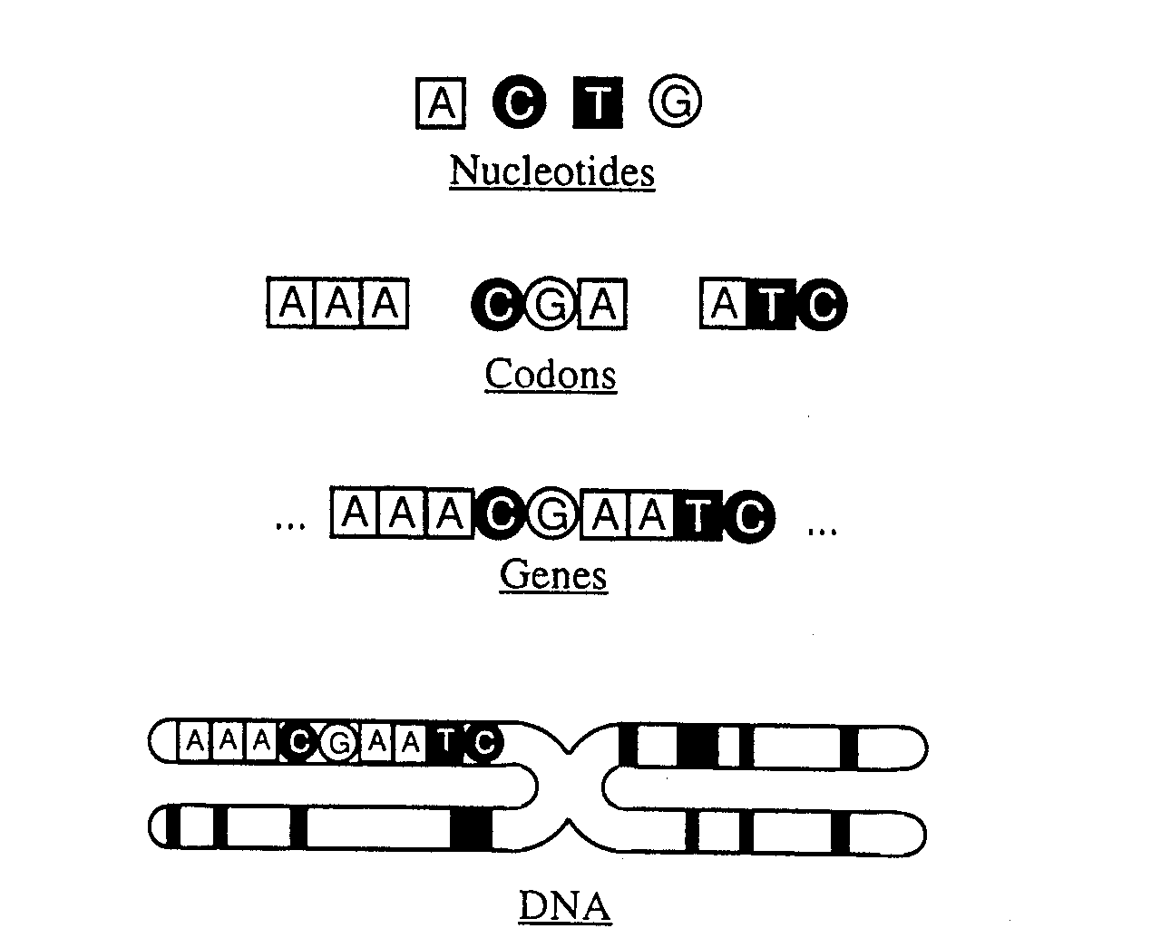
Example: genomic sequences
http://www.1000genomes.org/page.php
Full sequence of 1000 individuals
3*10⁹ nucleotides per person → 3*10¹² nucleotides
Lots more data in fact: medical history of the persons, gene expression data

Slide 23
Example: environmental data
Climate data (just an example)
http://www.ncdc.gov/oa/climate/ghcn-monthly/index.php
“a database of temperature, precipitation and pressure records managed by the National Climatic Data Center, Arizona State University and the Carbon Dioxide Information Analysis Center”
“6000 temperature stations, 7500 precipitation stations, 2000 pressure stations”
Spatiotemporal data

Slide 24
So, what is Data?
Attributes
Collection of data objects and their attributes
An attribute is a property or characteristic of an object
Examples: eye color of a person, temperature, etc.
Attribute is also known as variable, field, characteristic, or feature
A collection of attributes describe an object
Object is also known as record, point, case, sample, entity, or instance
Objects
Size: Number of objects
Dimensionality: Number of attributes
Sparsity: Number of populated
object-attribute pairs

Slide 25
Types of Attributes
There are different types of attributes
Categorical
Examples: eye color, zip codes, words, rankings (e.g, good, fair, bad), height in {tall, medium, short}
Numeric
Examples: dates, temperature, time, length, value, count.
Discrete (counts) vs Continuous (temperature)
Special case: Binary attributes (yes/no, exists/not exists)

Slide 26
Numeric Record Data
If data objects have the same fixed set of numeric attributes, then the data objects can be thought of as points in a multi-dimensional space, where each dimension represents a distinct attribute
Such data set can be represented by an n-by-d data matrix, where there are n rows, one for each object, and d columns, one for each attribute

Slide 27
Categorical Data
Data that consists of a collection of records, each of which consists of a fixed set of categorical attributes

Slide 28
Document Data
Each document becomes a `term' vector,
each term is a component (attribute) of the vector,
the value of each component is the number of times the corresponding term occurs in the document.
Bag-of-words representation – no ordering

Slide 29
Transaction Data
Each record (transaction) is a set of items.
A set of items can also be represented as a binary vector, where each attribute is an item.
A document can also be represented as a set of words (no counts)
Sparsity: average number of products bought by a customer

Slide 30
Ordered Data
Genomic sequence data
Data is a long ordered string

Slide 31
Graph Data
Examples: Web graph and HTML Links

Slide 32
Types of data
Numeric data: Each object is a point in a multidimensional space
Categorical data: Each object is a vector of categorical values
Set data: Each object is a set of values (with or without counts)
Sets can also be represented as binary vectors, or vectors of counts
Ordered sequences: Each object is an ordered sequence of values.
Graph data

Slide 33
What can you do with the data?
Suppose that you are the owner of a supermarket and you have collected billions of market basket data. What information would you extract from it and how would you use it?
What if this was an online store?
Product placement
Catalog creation
Recommendations

Slide 34
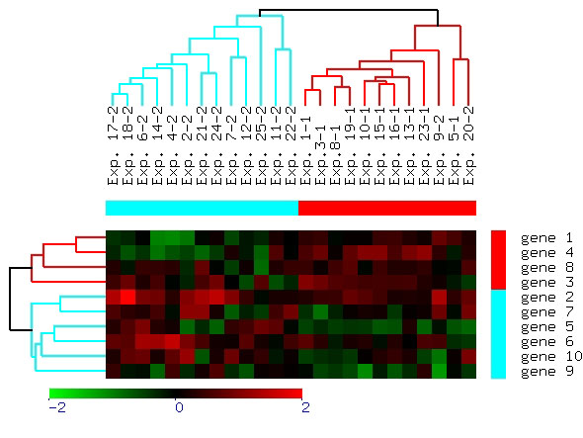
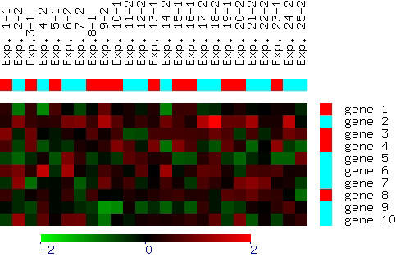
What can you do with the data?
Suppose you are biologist who has microarray expression data: thousands of genes, and their expression values over thousands of different settings (e.g. tissues). What information would you like to get out of your data?
Groups of genes and tissues

Slide 35

Why Mine Data? Commercial Viewpoint
Lots of data is being collected and warehoused
Web data, e-commerce
purchases at department/ grocery stores
Bank/Credit Card transactions
Computers have become cheaper and more powerful
Competitive Pressure is Strong
Provide better, customized services for an edge (e.g. in Customer Relationship Management)

Slide 36
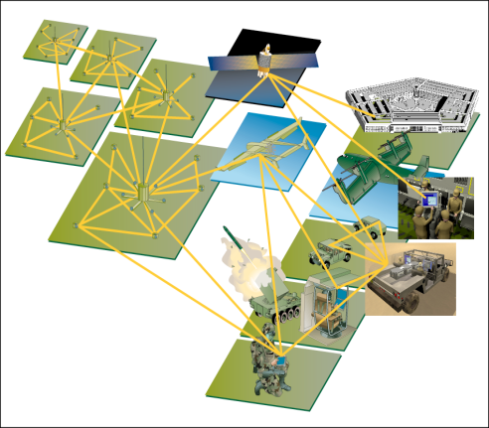
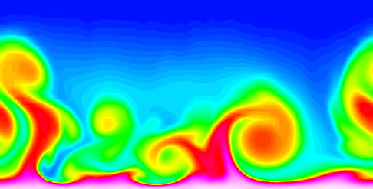
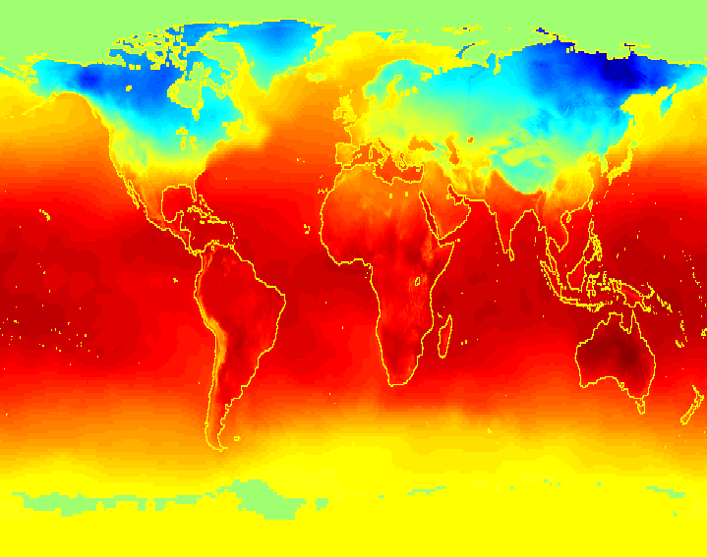
Why Mine Data? Scientific Viewpoint
Data collected and stored at enormous speeds (GB/hour)
remote sensors on a satellite
telescopes scanning the skies
microarrays generating gene expression data
scientific simulations generating terabytes of data
Traditional techniques infeasible for raw data
Data mining may help scientists
in classifying and segmenting data
in Hypothesis Formation

Slide 37
What is Data Mining again?
“Data mining is the analysis of (often large) observational data sets to find unsuspected relationships and to summarize the data in novel ways that are both understandable and useful to the data analyst” (Hand, Mannila, Smyth)
“Data mining is the discovery of models for data” (Rajaraman, Ullman)
We can have the following types of models
Models that explain the data (e.g., a single function)
Models that predict the future data instances.
Models that summarize the data
Models the extract the most prominent features of the data.

Slide 38
Data Mining Tasks...
Classification [Predictive]
Clustering [Descriptive]
Association Rule Discovery [Descriptive]
Sequential Pattern Discovery [Descriptive]
Regression [Predictive]
Deviation Detection [Predictive]

Slide 39
Classification: Definition
Given a collection of records (training set )
Each record contains a set of attributes, one of the attributes is the class.
Find a model for class attribute as a function of the values of other attributes.
Goal: previously unseen records should be assigned a class as accurately as possible.
A test set is used to determine the accuracy of the model. Usually, the given data set is divided into training and test sets, with training set used to build the model and test set used to validate it.

Slide 40
Classification Example
categorical
categorical
continuous
class
Test
Set
Learn
Classifier
Training
Set
Model

Slide 41
Classification: Application 1
Direct Marketing
Goal: Reduce cost of mailing by targeting a set of consumers likely to buy a new cell-phone product.
Approach:
Use the data for a similar product introduced before.
We know which customers decided to buy and which decided otherwise. This {buy, don’t buy} decision forms the class attribute.
Collect various demographic, lifestyle, and company-interaction related information about all such customers.
Type of business, where they stay, how much they earn, etc.
Use this information as input attributes to learn a classifier model.

Slide 42
Classification: Application 2
Fraud Detection
Goal: Predict fraudulent cases in credit card transactions.
Approach:
Use credit card transactions and the information on its account-holder as attributes.
When does a customer buy, what does he buy, how often he pays on time, etc
Label past transactions as fraud or fair transactions. This forms the class attribute.
Learn a model for the class of the transactions.
Use this model to detect fraud by observing credit card transactions on an account.

Slide 43
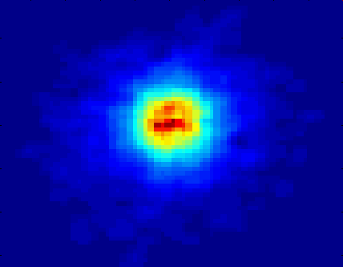
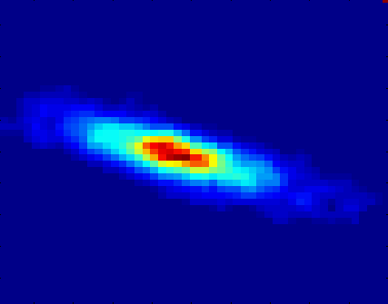
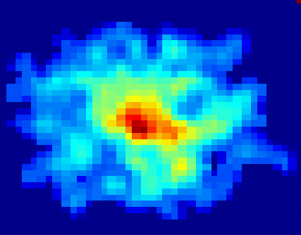
Classifying Galaxies
Early
Class:
Stages of Formation
Attributes:
Image features,
Characteristics of light waves received, etc.
Intermediate
Late
Data Size:
72 million stars, 20 million galaxies
Object Catalog: 9 GB
Image Database: 150 GB

Slide 44
Clustering Definition
Given a set of data points, each having a set of attributes, and a similarity measure among them, find clusters such that
Data points in one cluster are more similar to one another.
Data points in separate clusters are less similar to one another.
Similarity Measures:
Euclidean Distance if attributes are continuous.
Other Problem-specific Measures.

Slide 45
Clustering Definition
Intracluster distances
are minimized
Intercluster distances
are maximized

Slide 46
Clustering: Application 1
Market Segmentation:
Goal: subdivide a market into distinct subsets of customers where any subset may conceivably be selected as a market target to be reached with a distinct marketing mix.
Approach:
Collect different attributes of customers based on their geographical and lifestyle related information.
Find clusters of similar customers.
Measure the clustering quality by observing buying patterns of customers in same cluster vs. those from different clusters.

Slide 47
Clustering: Application 2
Bioinformatics applications:
Goal: Group genes and tissues together such that genes are co-expressed on the same tissues

Slide 48
Clustering: Application 2
Document Clustering:
Goal: To find groups of documents that are similar to each other based on the important terms appearing in them.
Approach:
To identify frequently occurring terms in each document.
Form a similarity measure based on the frequencies of different terms.
Use it to cluster.
Gain:
Information Retrieval can utilize the clusters to relate a new document or search term to clustered documents.

Slide 49
Illustrating Document Clustering
Clustering Points: 3204 Articles of Los Angeles Times.
Similarity Measure: How many words are common in these documents (after some word filtering).

Slide 50
Frequent Itemsets and Association Rules
Given a set of records each of which contain some number of items from a given collection;
Identify sets of items (itemsets) occurring frequently together
Produce dependency rules which will predict occurrence of an item based on occurrences of other items.
Itemsets Discovered:
{Milk,Coke}
{Diaper, Milk}
Rules Discovered:
{Milk} --> {Coke}
{Diaper, Milk} --> {Beer}

Slide 51
Frequent Itemsets: Applications
Text mining: finding associated phrases in text
There are lots of documents that contain the phrases “association rules”, “data mining” and “efficient algorithm”
Recommendations:
Users who buy this item often buy this item as well
Users who watched James Bond movies, also watched Jason Bourne movies.
Recommendations make use of item and user similarity

Slide 52
Association Rule Discovery: Application
Supermarket shelf management.
Goal: To identify items that are bought together by sufficiently many customers.
Approach: Process the point-of-sale data collected with barcode scanners to find dependencies among items.
A classic rule --
If a customer buys diaper and milk, then he is very likely to buy beer.
So, don’t be surprised if you find six-packs stacked next to diapers!

Slide 53
Sequential pattern mining
Sequential pattern mining:
A sequential rule: A→ B, says that event A will be immediately followed by event B with a certain confidence.

Slide 54
Regression
Predict a value of a given continuous valued variable based on the values of other variables, assuming a linear or nonlinear model of dependency.
Greatly studied in statistics, neural network fields.
Examples:
Predicting sales amounts of new product based on advertising expenditure.
Predicting wind velocities as a function of temperature, humidity, air pressure, etc.
Time series prediction of stock market indices.

Slide 55
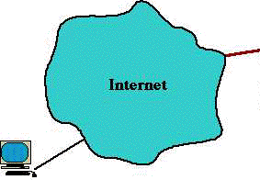
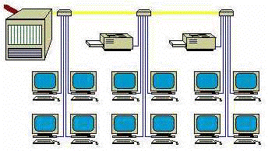
Deviation/Anomaly Detection
Detect significant deviations from normal behavior
Discovering the most significant changes in data
Applications:
Credit Card Fraud Detection
Network Intrusion Detection
Typical network traffic at University level may reach over 100 million connections per day

Slide 56
Challenges of Data Mining
Scalability
Dimensionality
Complex and Heterogeneous Data
Data Quality
Data Ownership and Distribution
Privacy Preservation
Streaming Data

Slide 57
Thanks

